Slide 1
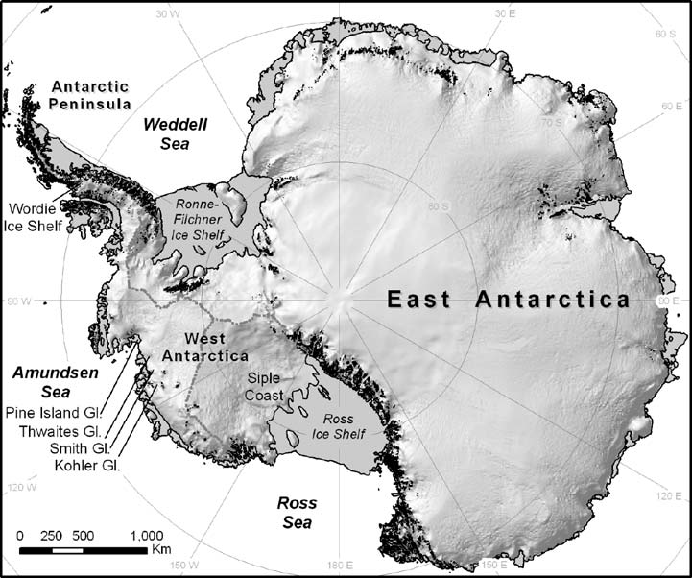
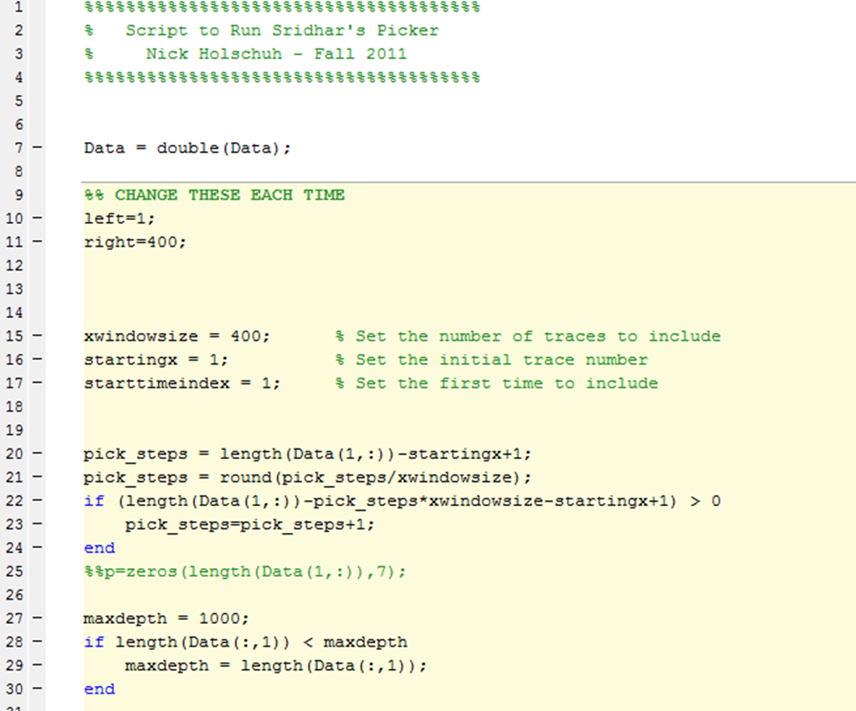
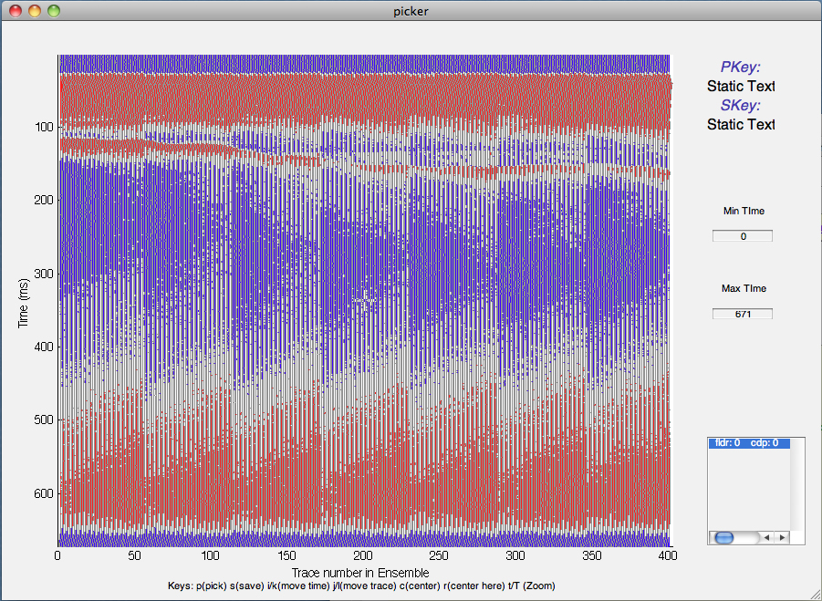
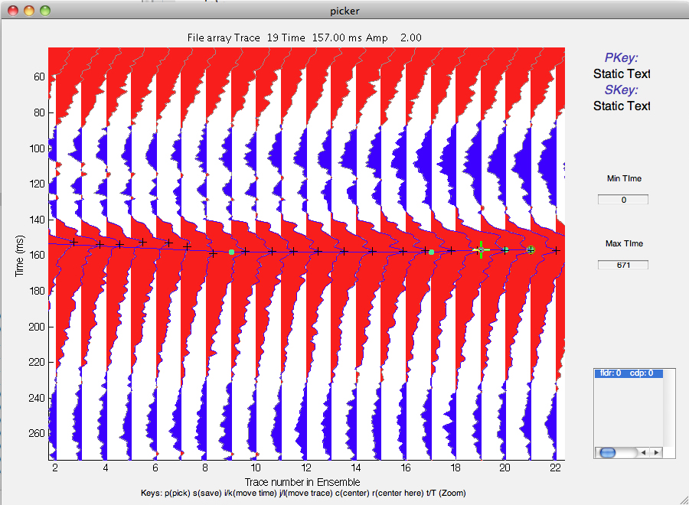
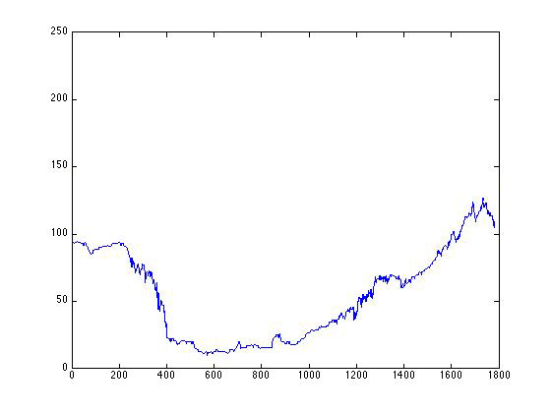
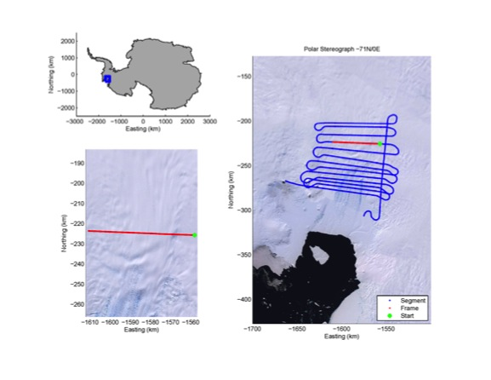
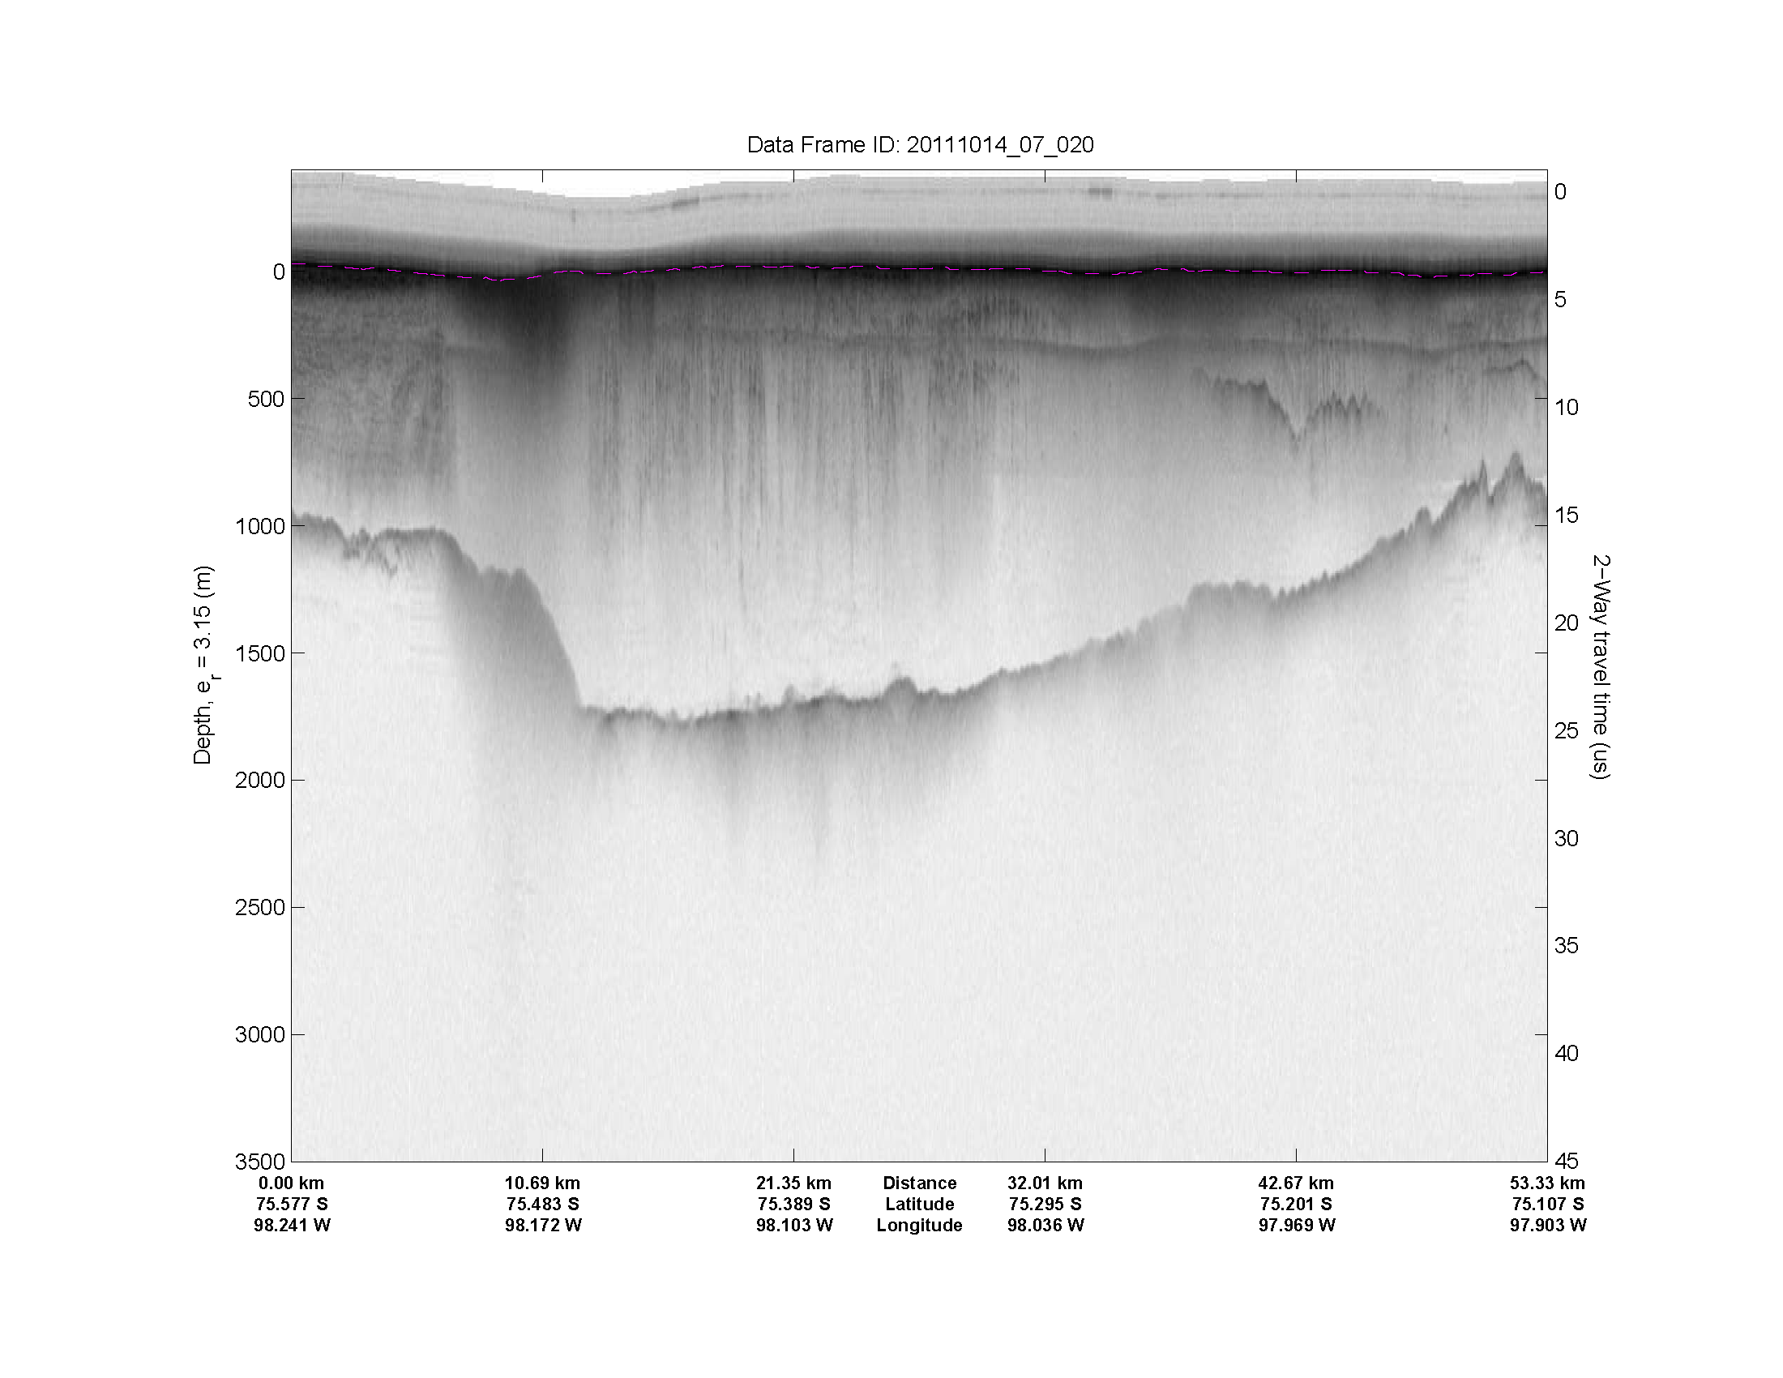
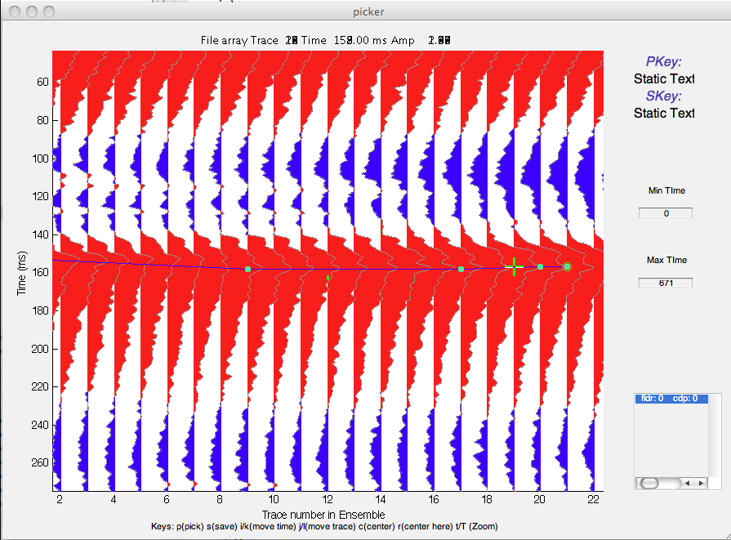
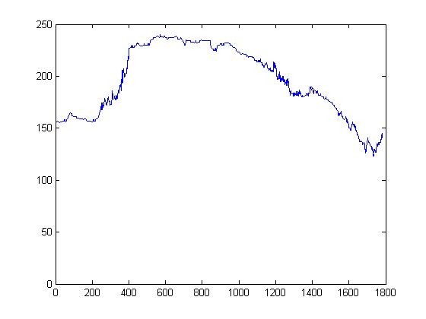
Using CReSIS Radar Data to Determine Ice Thickness and Surface Elevation at Pine Island Glacier
Team Members: Nyema Barmore (ECSU), Glenn Michael Koch (ECSU) Mentor: Dr. Sridar Anandakrishnan (PSU), Peter Burkett (PSU )
Abstract
The Pine Island Glacier region of Antarctica is an area under intense scrutiny because of its sensitivity to climate change. Pine Island Glacier is located in Western Antarctica and drains a large portion of the West Antarctic Ice Sheet. It has shown to be particularly vulnerable to glacial ablation [1]. The 2012 Research Experience for Undergraduates (REU), Ocean Marine Polar Science (OMPS), Penn State Team analyzed CReSIS radar data to identify the ice-surface and ice-bottom features. From this, both elevation and ice thickness at Pine Island Glacier were determined. The team utilized MATLAB along with an add-on picker program; The Penn State Environment for Seismic Processing (PSESP), developed at Pennsylvania State University. MATLAB is a programming environment that analyzes data as well as many other technical processing applications. With the picker program the team selected specific, maximum-strength radar peaks on individual radar traces and applied a formula to compute the distance traveled by the signal. The difference between the distance traveled from the surface and bottom features was calculated to produce an ice thickness map. The team results will provide data that will aid in modeling of the Pine Island Glacier.
Methodology
The first step in the data analysis was to load the data set to be analyzed into the PSESP.
Ice Calculation
Ice Thickness Calculation:
[(((Bottom horizon – surface horizon) /10)/2)*170m/uS]
Step 1: Take the Picker difference value of time between the bottom and surface horizon.
Step 2: Divide by 10. This converts it from "samples" to real time (in micro seconds).
Step 3:Divide that time by 2. This converts the "two way" travel time (going from the plane to the bottom of the ice and back to plane) into a one way travel time (from the plane to the bottom of the ice).
Step 4: Multiply that number by 170 (which converts time to distance because radar waves travel at 170 meters/uS in ice).
Pine Island Bay
(100° West Longitude - 112° West Longitude)
Plotted bottom and top surface
Conclusion
Analysis provided numerical elevation data from CReSIS radar data sets that could be plotted and compared to echogram images
Data plots did correlate to echogram snapshot images
Data plots provided a reliable source to perform ice thickness calculations
Study Area
Future Works
With the completed calculations of Pine Island Glacier ice thickness, a 3D model of the glacier can be created. The 3D model may be used in several different ways to improve upon the study of the glacier. One way the model may be used is to compare present day and future ice sheet thickness.
Loaded data displayed as a 400 trace data panel
Automatic pick by PSESP
Plotted bottom surface
ACKNOWLEDGEMENTS
The team would like to acknowledge Dr. Linda B. Hayden, Dr. Sridar Anandakrishnan, and Mr. Peter Burkett for the guidance provided during the period of this research.
Flight Path With Single Pass Highlighted
References
Echogram
[1] | Paterson, Cuffey, "The Physics of Glaciers".
[2] | N. S. a. I. D. Center, "All About Glaciers," [Online]. Available: http://nsidc.org/cryosphere/glaciers/questions/what.html. [Accessed 2 July 2012
[3] | "Eccyclopedia.com," [Online]. Available: http://www.encyclopedia.com/doc/1O13-calving.html. [Accessed 2 July 2012].
[4] | Research.gov, "Multi-Radar Mapping of Polar Ice," [Online]. Available: http://www.research.gov/research-portal/appmanager/base/desktop. [Accessed 2 July 2012
[5] | "Merriam-Webster.com," [Online]. Available: http://www.merriam-webster.com/dictionary/radar. [Accessed 9 July 2012].
[6] | "Molecular Expressions," [Online]. Available: http://www.micro.magnet.fsu.edu/primer/java/speedoflight/index.html. [Accessed 9 July 2012].
Manually picked panel
Plotted bottom surface

